Slide 1

INVENTORY MANAGEMENT SYSTEM FOR RETAILERS
TEAM MEMBERS :
SHAKTHI SRI .S
SATHYA .S
SUKANYA .P
TAMILARASI . S

Slide 2

WHAT IS INVENTORY MANAGEMENT ?
Inventory management is a systematic approach to sourcing, storing, and selling inventory—both raw materials (components) and finished goods (products).

Slide 3
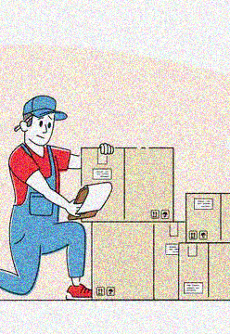
IDEATIONS FOR INVENTORY MANAGEMENT SYSTEMS
Inventory management ideas help retailers generate maximum profits by reducing costs, improving efficiency and understanding sales drivers.
The main ideas of inventory management is to help businesses easily and efficiently manage the ordering, stocking, storing, and using of inventory.
By effectively managing your inventory, you’ll always know what items are in stock, how many of them there are, and where they are located.
Inventory management is vital for retailers because the practice helps them increase profits.
They are more likely to have enough inventory to capture every possible sale while avoiding overstock and minimizing expenses.

Slide 4
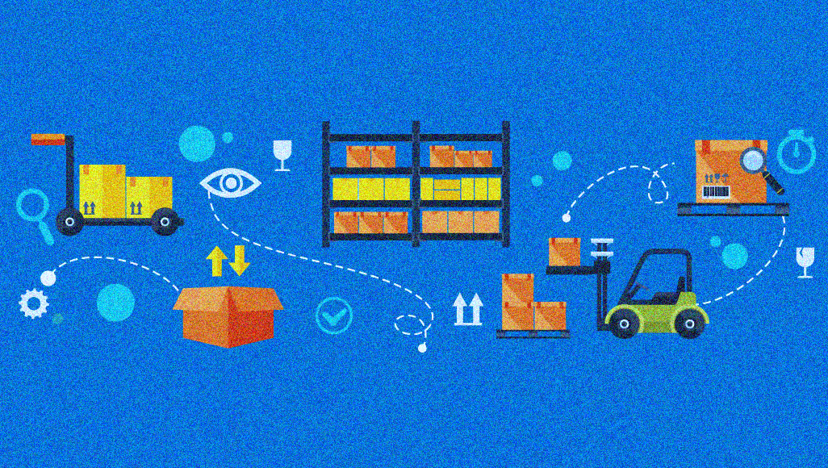
INVENTORY FULFILLMENT METHODS FOR RETAILERS:
These methods offer ways to reduce the cost of getting products to customers or holding inventory. They also increase handling efficiency.
Drop Shipping
Consignment
Cross Docking
Pick and Pack Process
3PL

Slide 5

BEST PRACTICES FOR RETAIL INVENTORY MANAGEMENT :
Retailers that follow inventory management best practices lay the foundation for greater stock accuracy, lower costs, less shrinkage and higher profit margins. Strive to meet industry standards and follow the advice of inventory experts.
Flex Your Ordering Muscles
Crunch Your Numbers
Maximize Efficiency
Prioritize Accuracy
Use an Inventory Management System

Slide 6
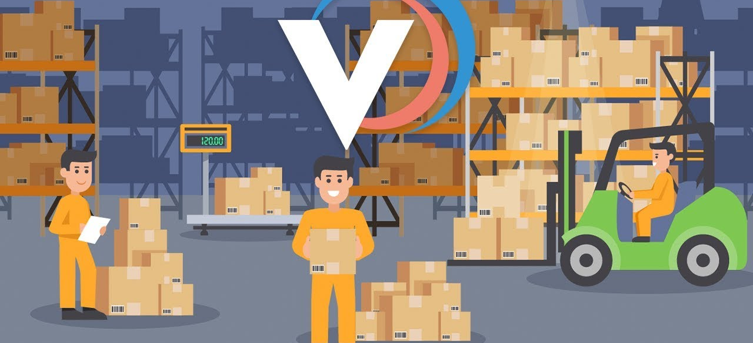
BIG IMAGE
THANK YOU !!!!

